Slide 1



JOB-JO Dissemination Report
ERASMUS+ PROGRAMME
Project Number: 598428-EPP-1-2018-1-JO-EPPKA2-CBHE-JP
Promoting youth employment in remote areas in Jordan

Slide 2
Tafila Technical University - The first Technical University in Jordan

Slide 3
JOB-JO -TTU activities
The Dissemination activities covered three areas:
Activities that cover engagement with current students
Activities that cover engagement with graduate students
Activities that cover engagement with local community

Slide 4
Activities that cover engagement with current students
Establishing a higher Council at CSTC for Regional Business Service Network (Location: CSTC, Date: July 2019)
Making an agreement with a private training center for Establishing Network Service between the TTU, CSTC and private sector (Location: Univ. President office, Date: Sep. 2019)
Establishing a special lab for Public safety and occupational health for Developing advanced training courses (Location: CSTC, Date: Dec. 2019)

Slide 5
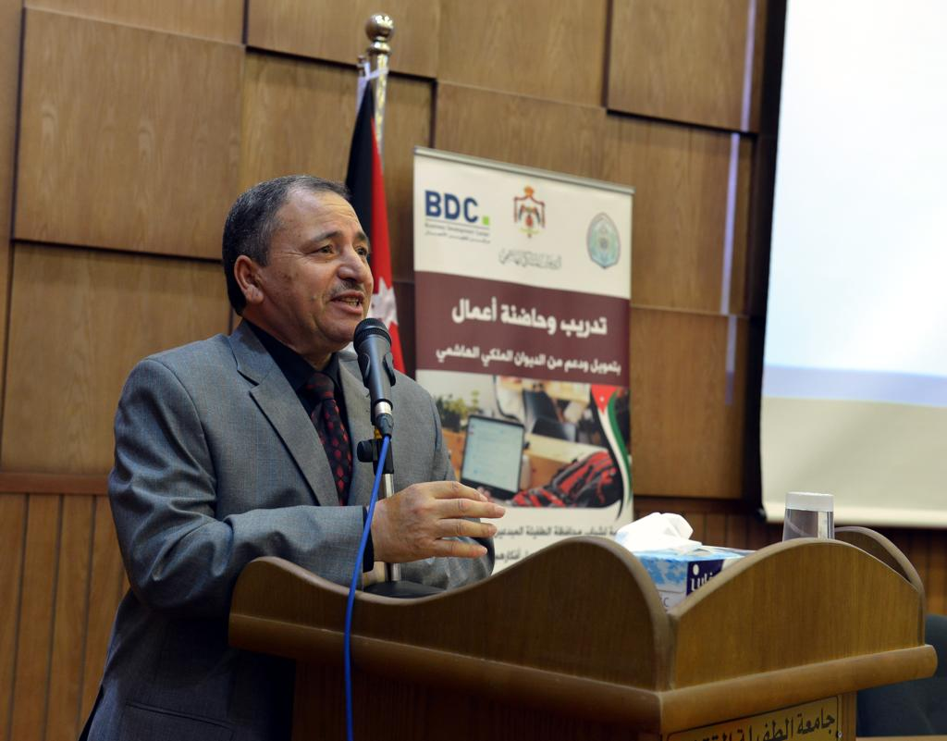
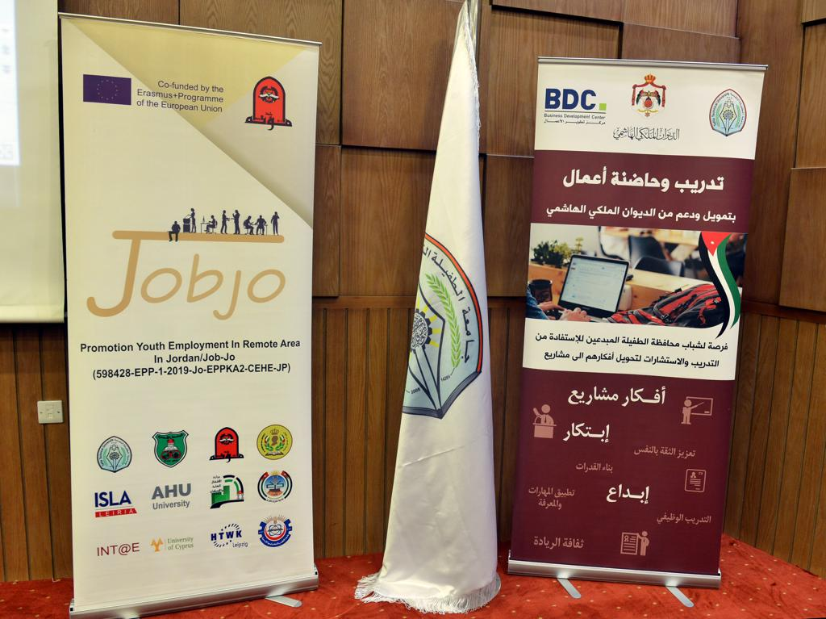
Activities that cover engagement with current students
Establishing a Business Development Office at TTU For developing business ideas of jobless into business projects (June 2019)

Slide 6
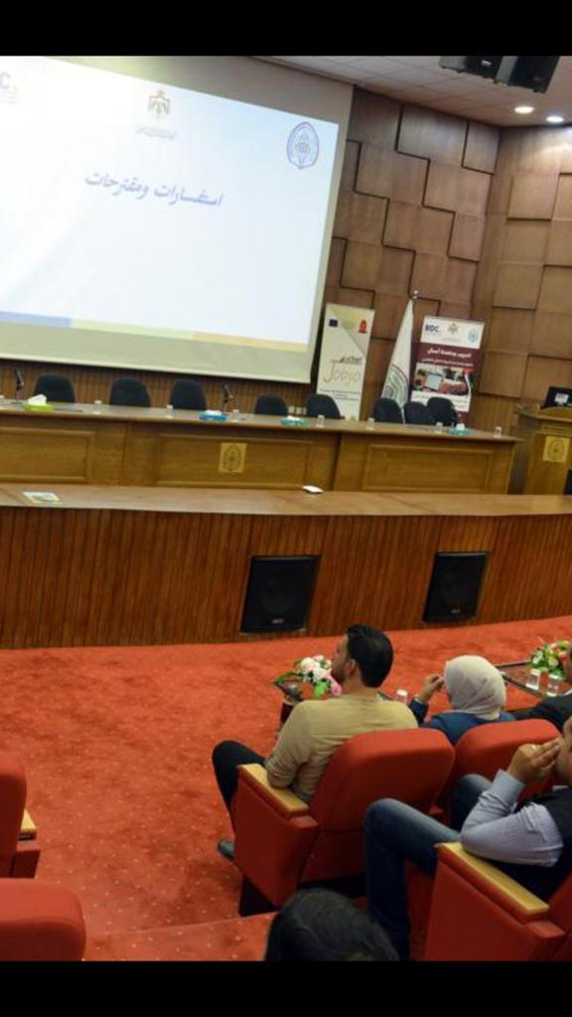
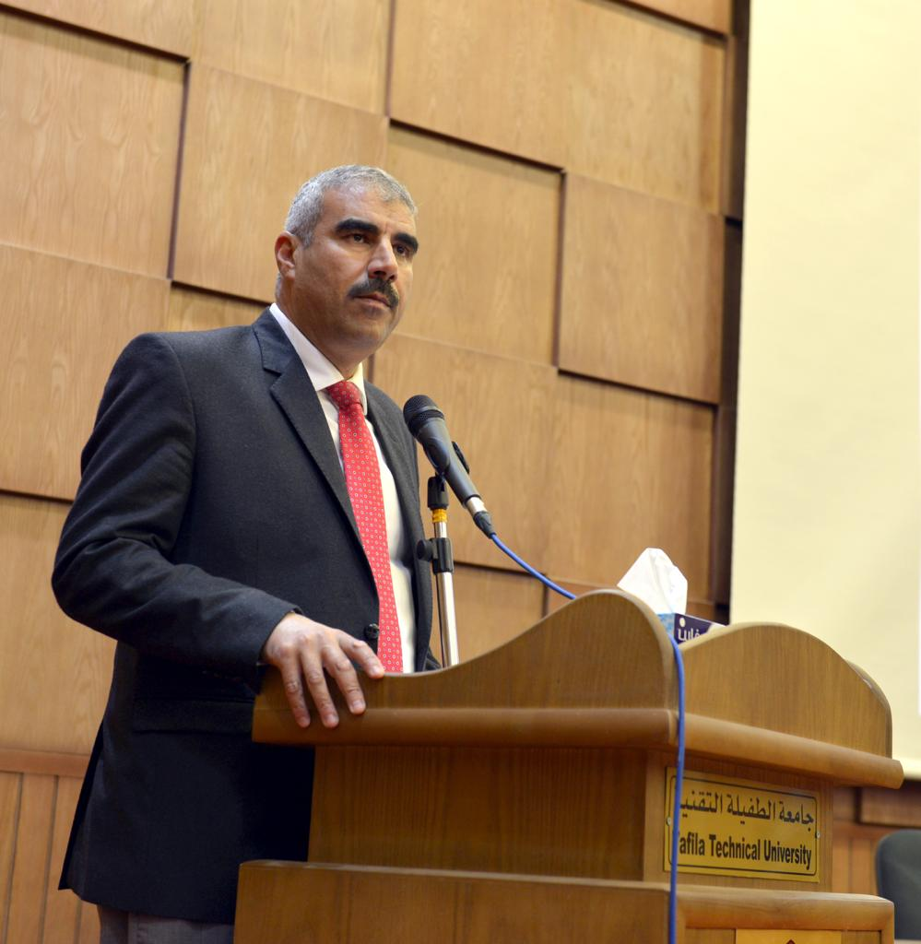
Activities that cover engagement with graduate students
Training Workshop for Graduate Students and Jobless in Requirements of Information Technology (June 2019)

Slide 7
Activities that cover engagement with graduate students
Training Workshop for Graduate Students
(Location: CSTC, Date: Nov. 2019)

Slide 8
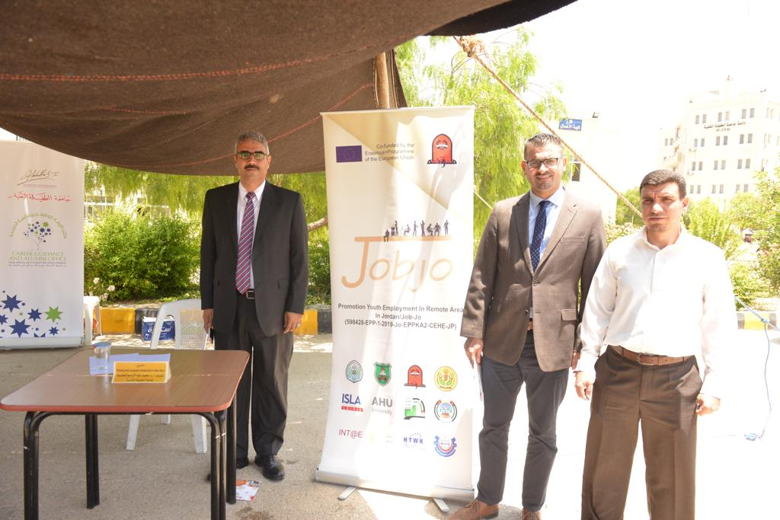
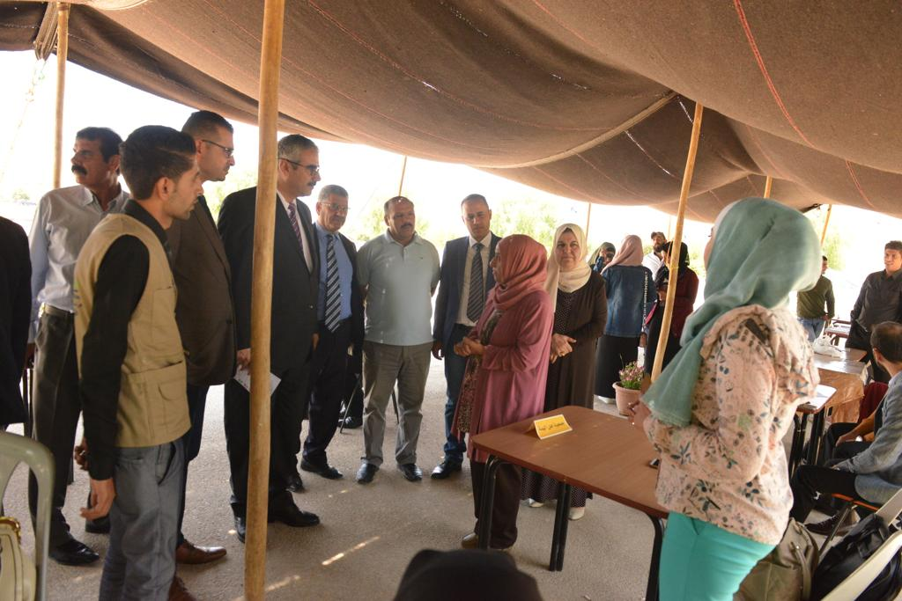
Activities that cover engagement with Local community
Job Fair for Job Seeker in cooperation with local community and NGOs
(Location: TTU, Date: June 2019)

Slide 9
Activities that cover engagement with Local community
Making an agreement with the ministry of work for Creating employment opportunities
(Location: Univ. President office, Date: Aug. 2019)

Slide 10
Thank You

